Slide 1
Continue from where we left off…
FORMS!

Slide 2

Styling Images

Slide 3
Why?
To beautify the image.
To give some context to the image.
To compartmentalise images.
Many more…

Slide 4
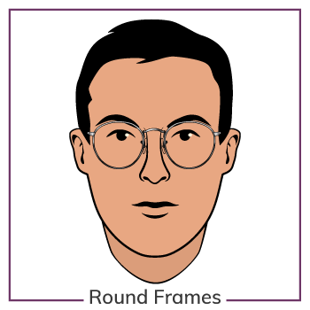
Borders
For example, what if we want our image to have a circle border? Or rounded corners?

Slide 5
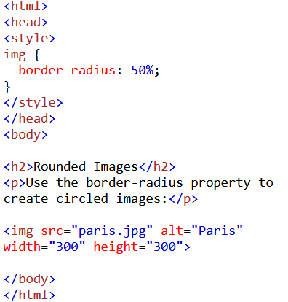
Rounded Images
Notes:
Border-radius changes the roundness of the corners.

Slide 6
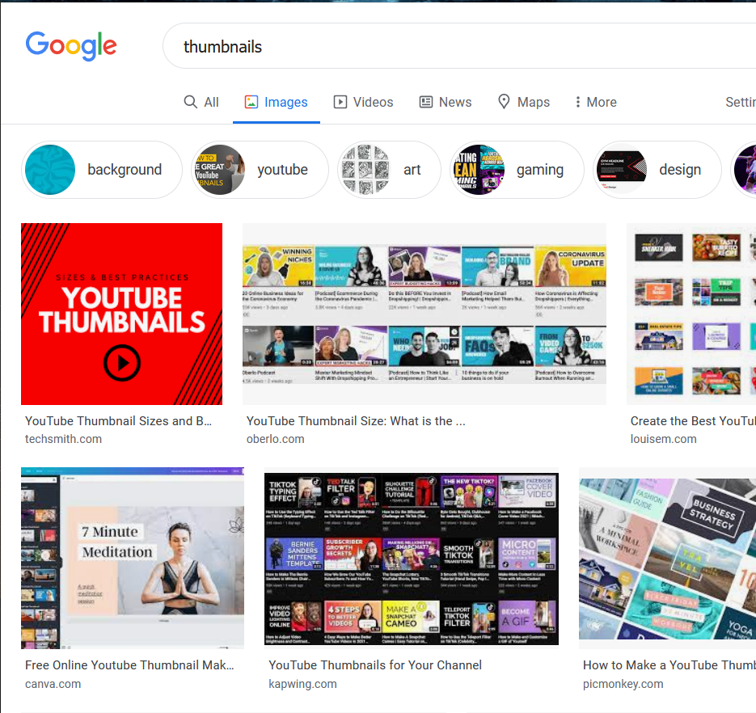
Thumbnail Links?

Slide 7
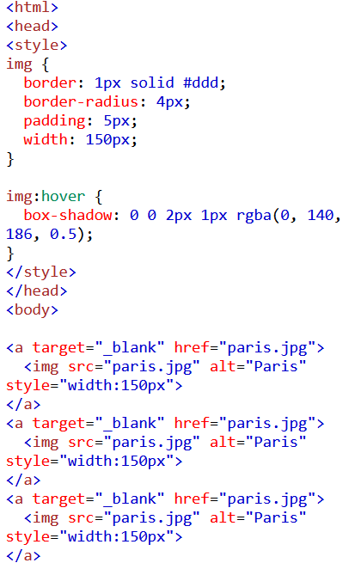
Thumbnail example
Notes:
Anchor tag to give it the link
Box-shadow gives a shadow effect when hovered

Slide 8
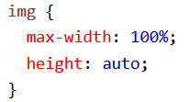
Responsive Images

Slide 9
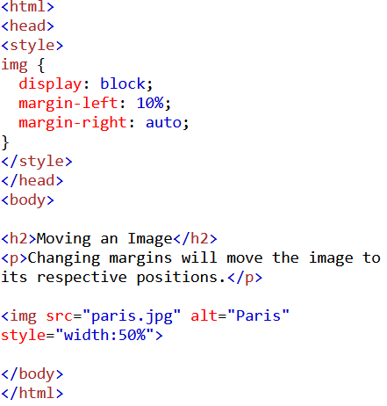
Moving an Image
Notes:
Margin moves the images to the left or right

Slide 10
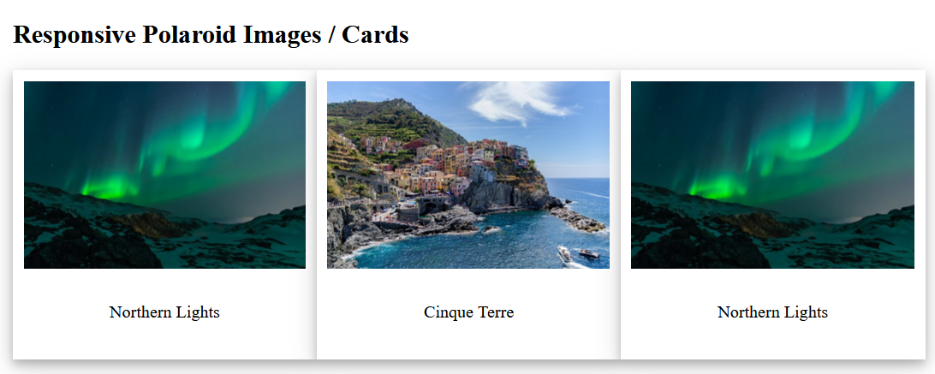
Polaroid Cards?

Slide 11
Polaroids
<html>
<head>
<style>
* {
box-sizing: border-box;
}
body {margin:25px;}
div.row {
display: flex;
}
div.polaroid {
padding: 10px;
background-color: white;
margin-bottom: 25px;
box-shadow: 0 4px 8px 0 rgba(0, 0, 0, 0.2), 0 6px 20px 0 rgba(0, 0, 0, 0.19);
}
div.polaroid:hover {
transform: scale(1.01);
}
div.container {
text-align: center;
padding: 10px 20px;
}
</style>
</head>
<body>
<h2>Responsive Polaroid Images / Cards</h2>
<div class="row">
<div class="polaroid">
<img src="lights600x400.jpg" alt="Norther Lights" style="width:100%">
<div class="container">
<p>Northern Lights</p>
</div>
</div>
<div class="polaroid">
<img src="img_5terre.jpg" alt="5 Terre" style="width:100%">
<div class="container">
<p>Cinque Terre</p>
</div>
</div>
<div class="polaroid">
<img src="lights600x400.jpg" alt="Norther Lights" style="width:100%">
<div class="container">
<p>Northern Lights</p>
</div>
</div>
</div>
</body>
</html>
Notes:
Flex: https://css-tricks.com/snippets/css/a-guide-to-flexbox/

Slide 12


Fade in descriptions

Slide 13
Example
<html>
<head>
<style>
.container {
position: relative;
width: 50%;
}
.image {
display: block;
width: 100%;
height: auto;
}
.overlay {
position: absolute;
top: 0;
bottom: 0;
left: 0;
right: 0;
height: 100%;
width: 100%;
opacity: 0;
transition: .5s ease;
background-color: #008CBA;
}
.container:hover .overlay {
opacity: 1;
}
.text {
color: white;
font-size: 20px;
position: absolute;
top: 50%;
left: 50%;
transform: translate(-50%, -50%);
-ms-transform: translate(-50%, -50%);
}
</style>
</head>
<body>
<h2>Fade in Overlay</h2>
<div class="container">
<img src="img_avatar.png" alt="Avatar" class="image">
<div class="overlay">
<div class="text">Hello World</div>
</div>
</div>
</body>
</html>

